Slide 1
HDP – CDP Upgradation

Slide 2
Pre-Requisite Checks
Backup the ambari and hive database schemas
Upgrade postgreSQL version to 10.x/11.x/12.x
Backup nameNode metadata directory
HDP 7.1.4 repository fdownload
CDP 7.1.4 repository download
Cloudera Manager repository download

Slide 3
Ambari-Upgrade
Step 1: Ambari upgradation from 2.x to 7.1.4
Download ambari repos.
Untar the repository
Ambari metrics collector Script to be run
Upgrade ambari server and agent.
Ambari server upgrade and setup
Launch Ambari intermediate version.
Note: The configuration changes will be done on all the nodes in the cluster servers.

Slide 4
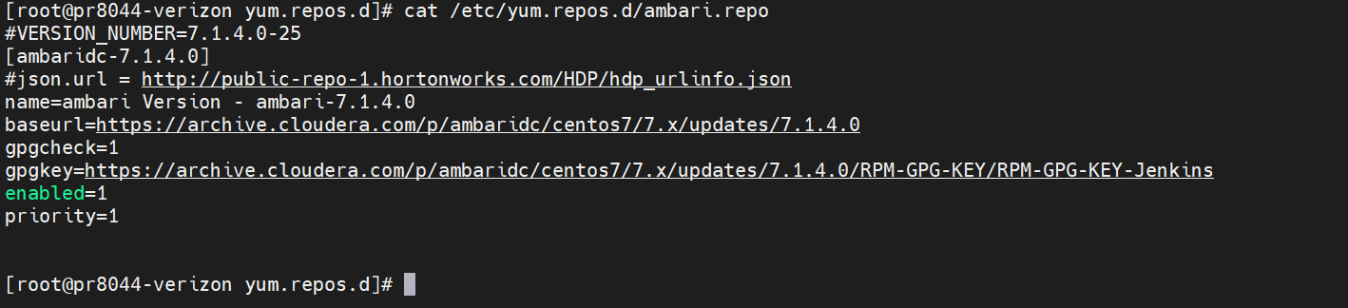
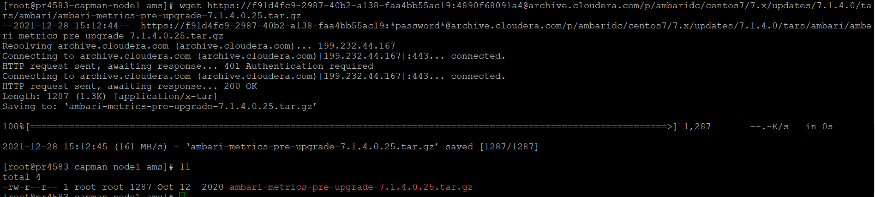
Ambari-Upgrade
Download ambari repos.
2. Download and run Ambari metrics collector Script

Slide 5
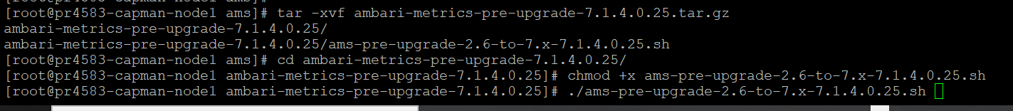
Ambari-Upgrade
3. Download and run Ambari metrics collector Script - Ambari Metrics Collector will shut down automatically.
Extract and run the pre-upgrade scriptExtract the pre-upgrade tarball: $ tar xvzf ambari-metrics-pre-upgrade-<version>.tar.gz
Change to the ambari-metrics-pre-upgrade-<version> directory. $ cd ambari-metrics-pre-upgrade-<version>
Make the pre-upgrade script executable: $ chmod +x ams-pre-upgrade-2.6-to-7.x-<version>.sh
Run the pre-upgrade script on all Metrics Collector hosts: $ ./ams-pre-upgrade-2.6-to-7.x-<version>.sh

Slide 6
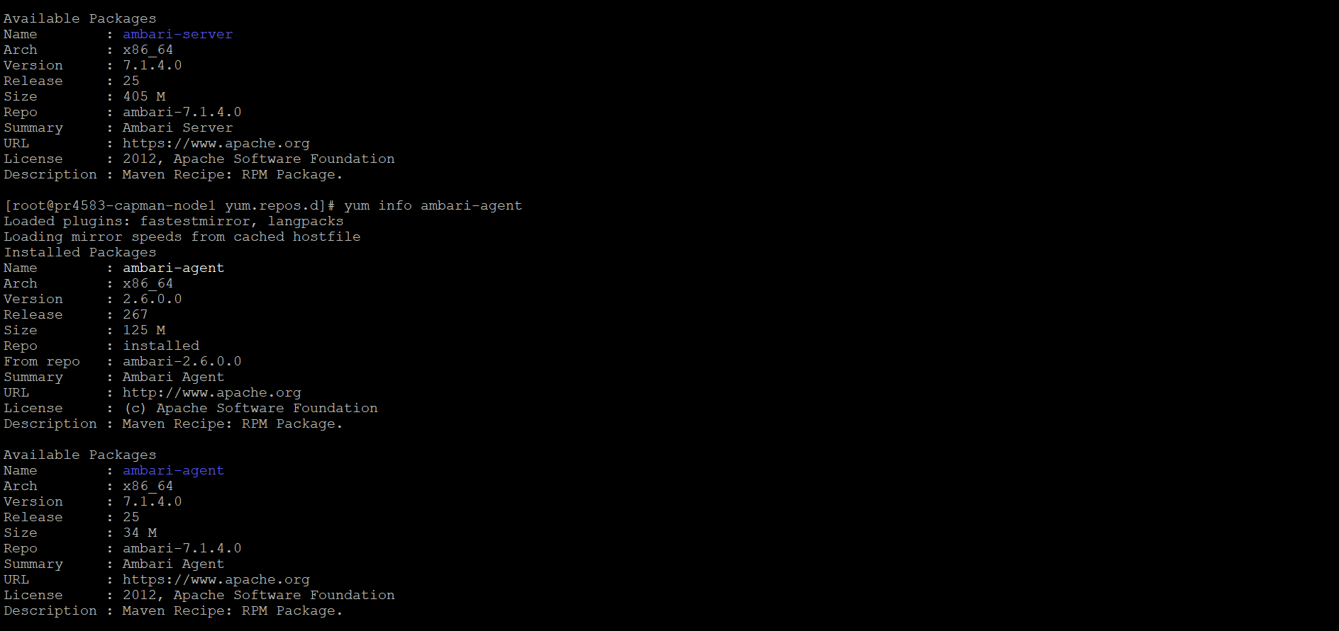
Ambari-Upgrade
Step 4: Ambari upgradation from 2.x to 7.1.4

Slide 7
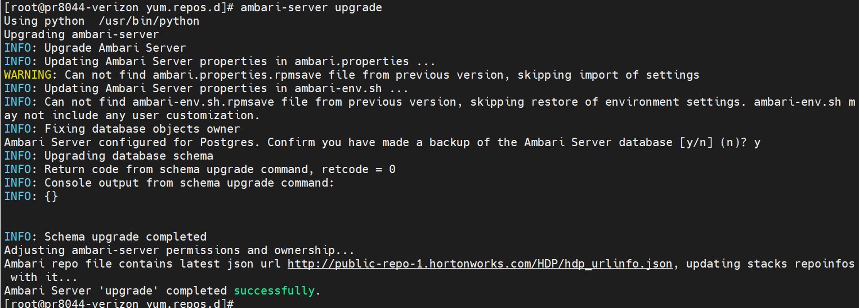
Ambari-Upgrade
Step 4: Ambari upgradation from 2.x to 7.1.4

Slide 8
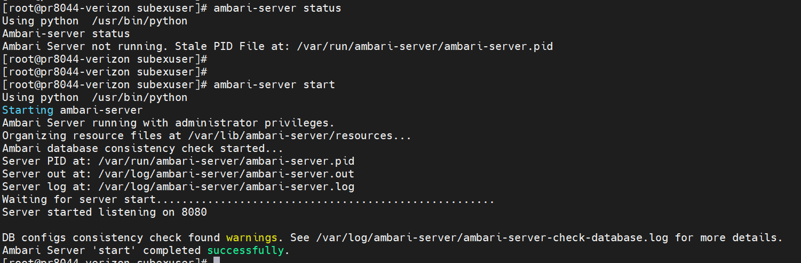
Start ambari server upgraded version
Step 5: Start ambari version 7.1.4

Slide 9
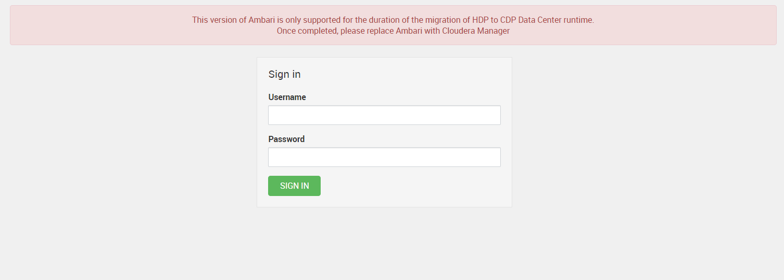
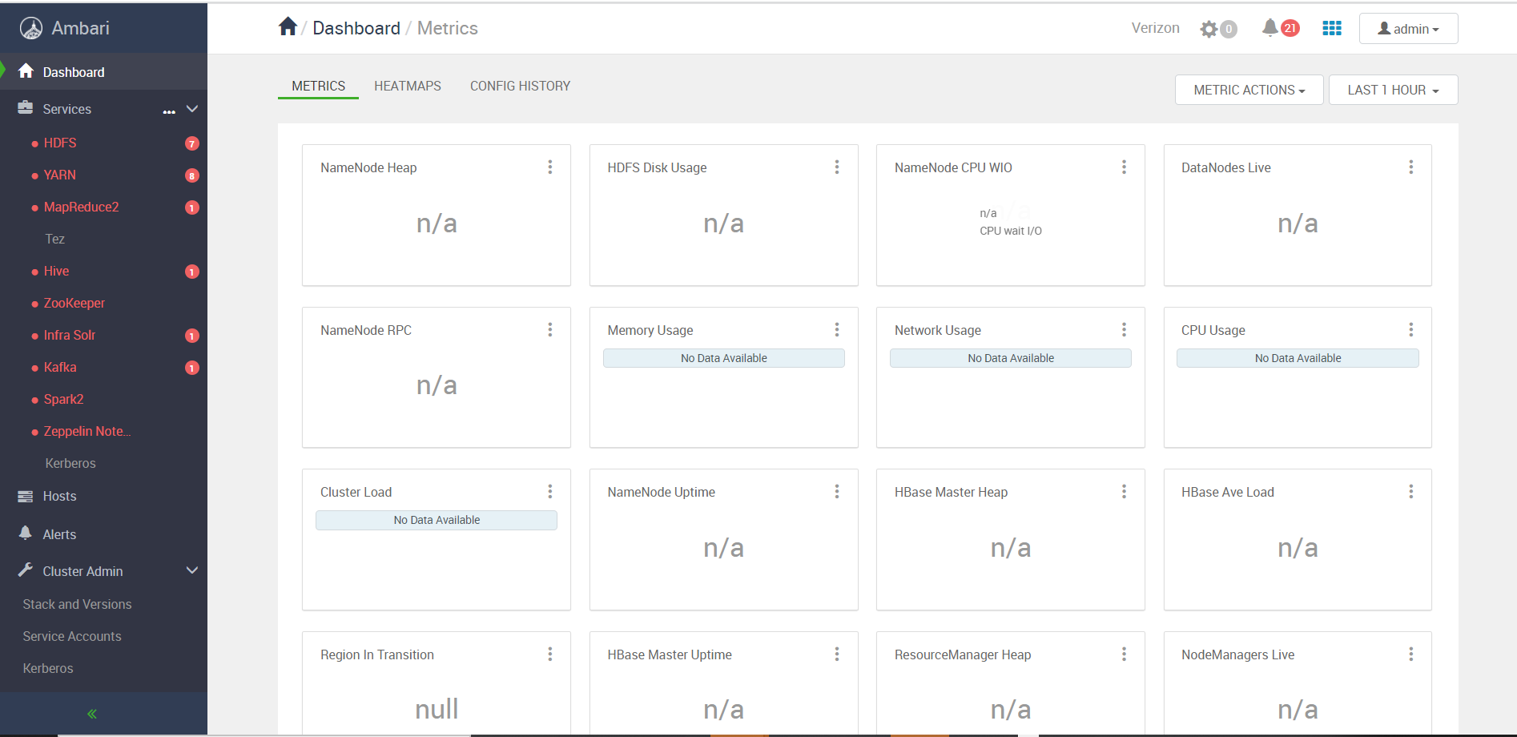
Upgraded Ambari UI
Note: Post ambari Upgrade start all the services and check

Slide 10
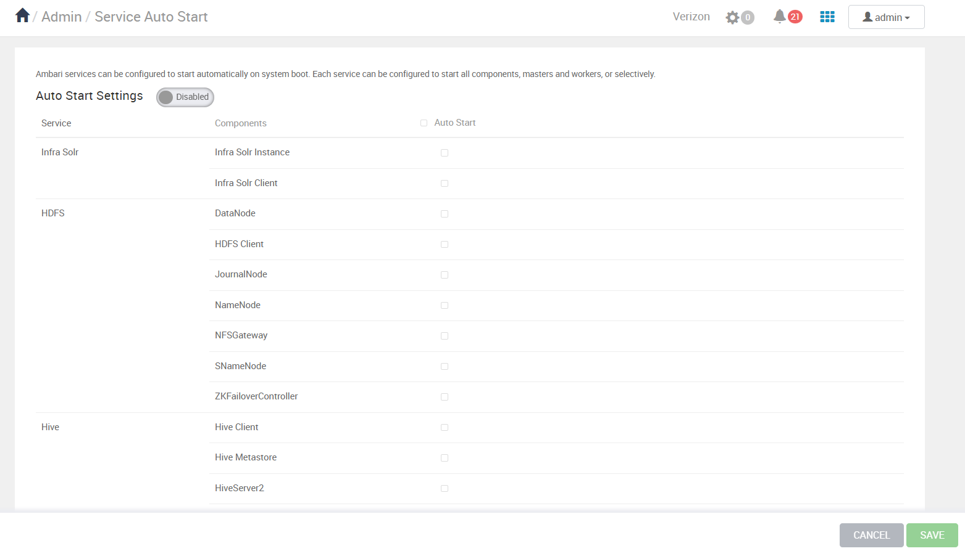
Turn off Services auto start for all the services and put Ambari metrics and smart sense to maintenance mode.
Note: Post ambari Upgrade start all the services and check

Slide 11
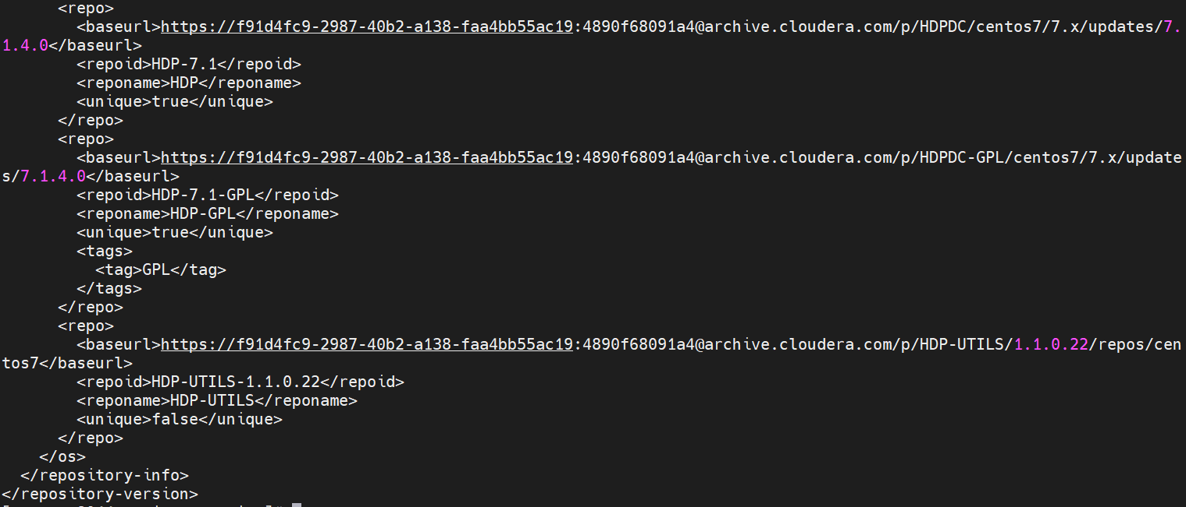
HDP Stack Upgrade to 7.1.4
Download HDP repos.

Slide 12
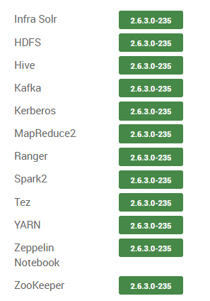
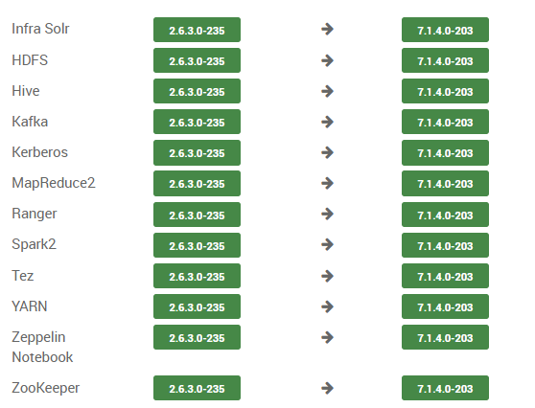
HDP Stack Upgrade to 7.1.4
2. Update the version in ambari UI.
Current Stack versions:
Target Stack versions:

Slide 13
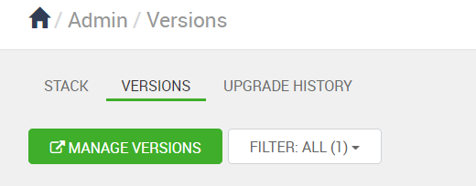
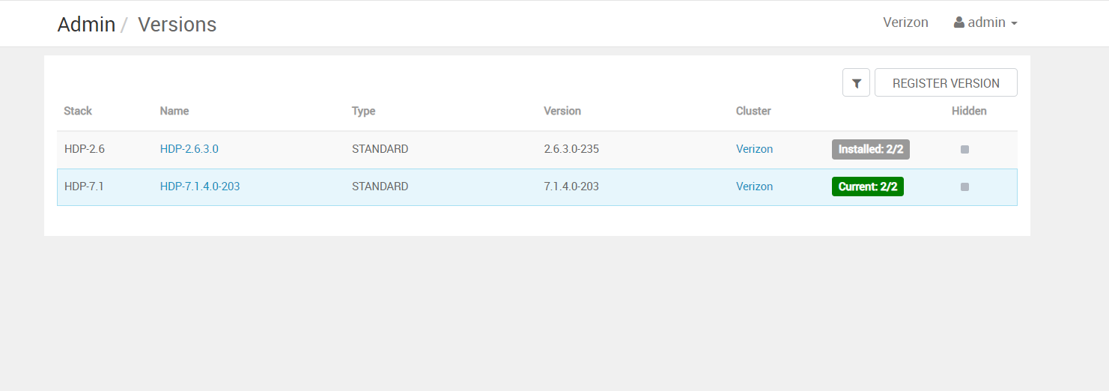
HDP Stack Upgrade to 7.1.4
2. Update the version in ambari UI.
Go To stack versions on Ambari UI.
Click on Versions
Click on Manage Versions.

Slide 14
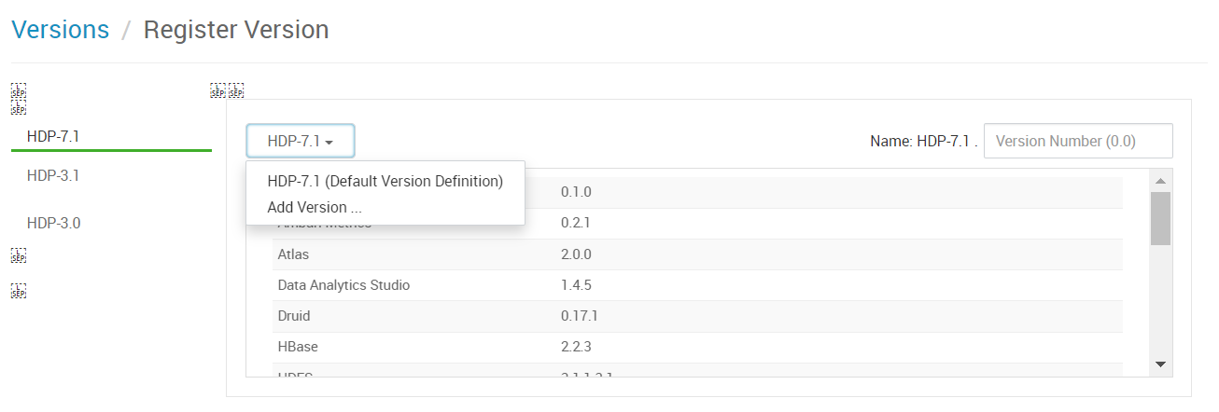
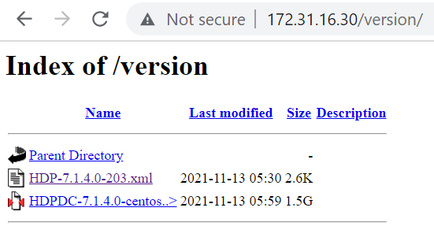
HDP Stack Upgrade to 7.1.4
2. Update the version in ambari UI.
4. Go To stack versions on Ambari UI.

Slide 15
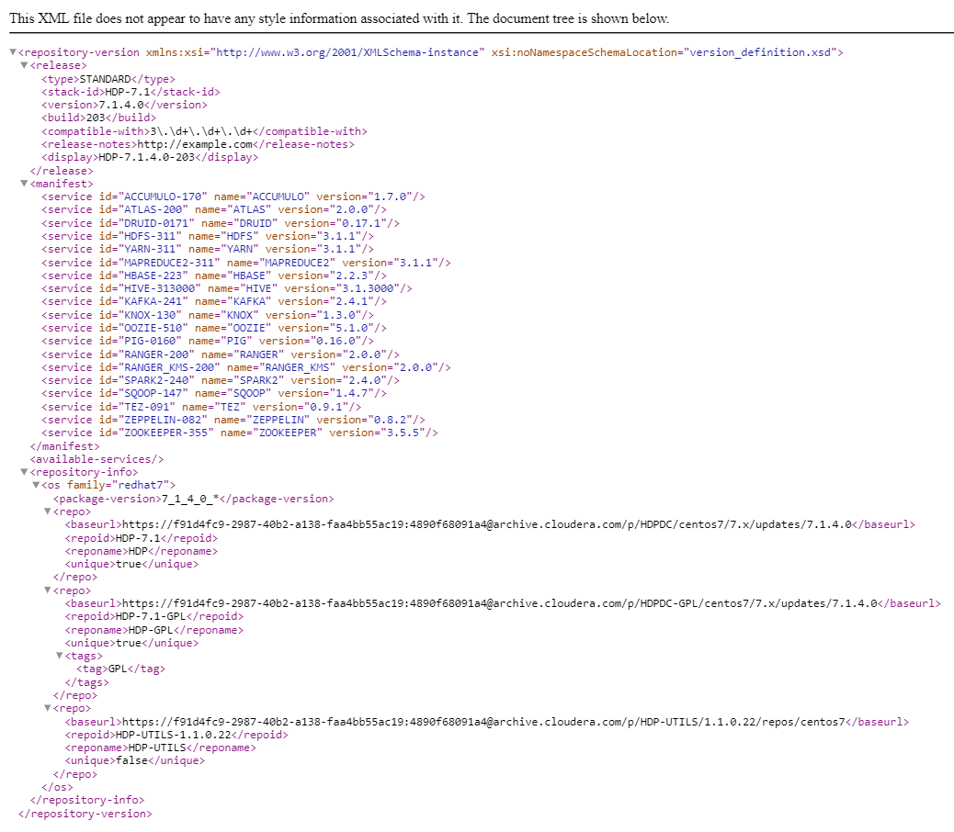
HDP Stack Upgrade to 7.1.4
Contents of Version File:

Slide 16
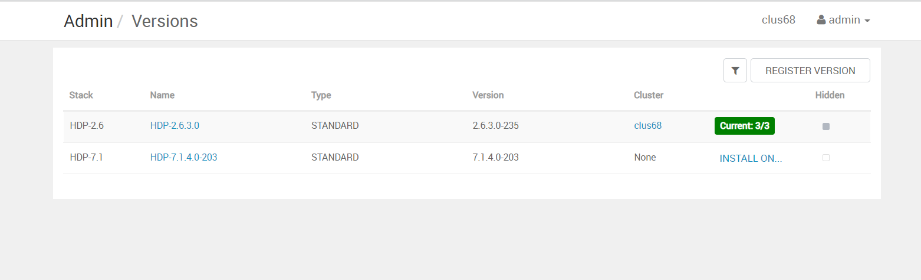
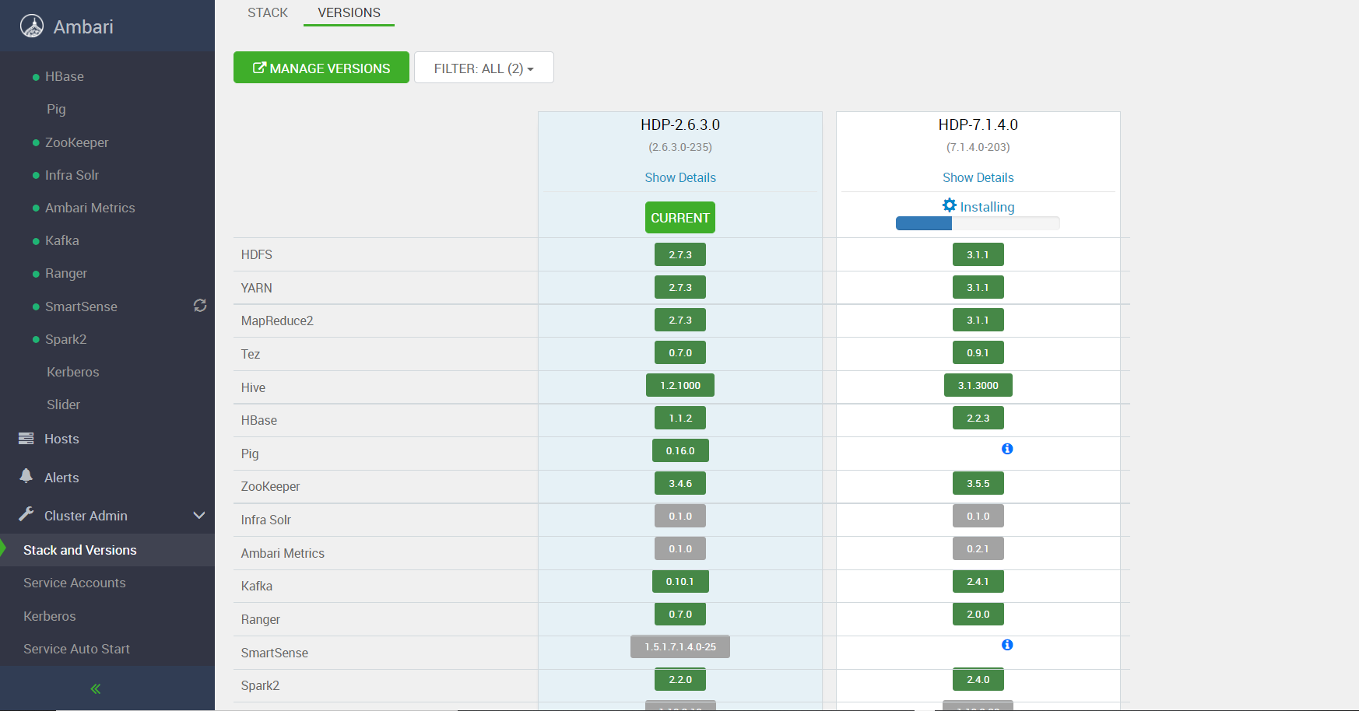
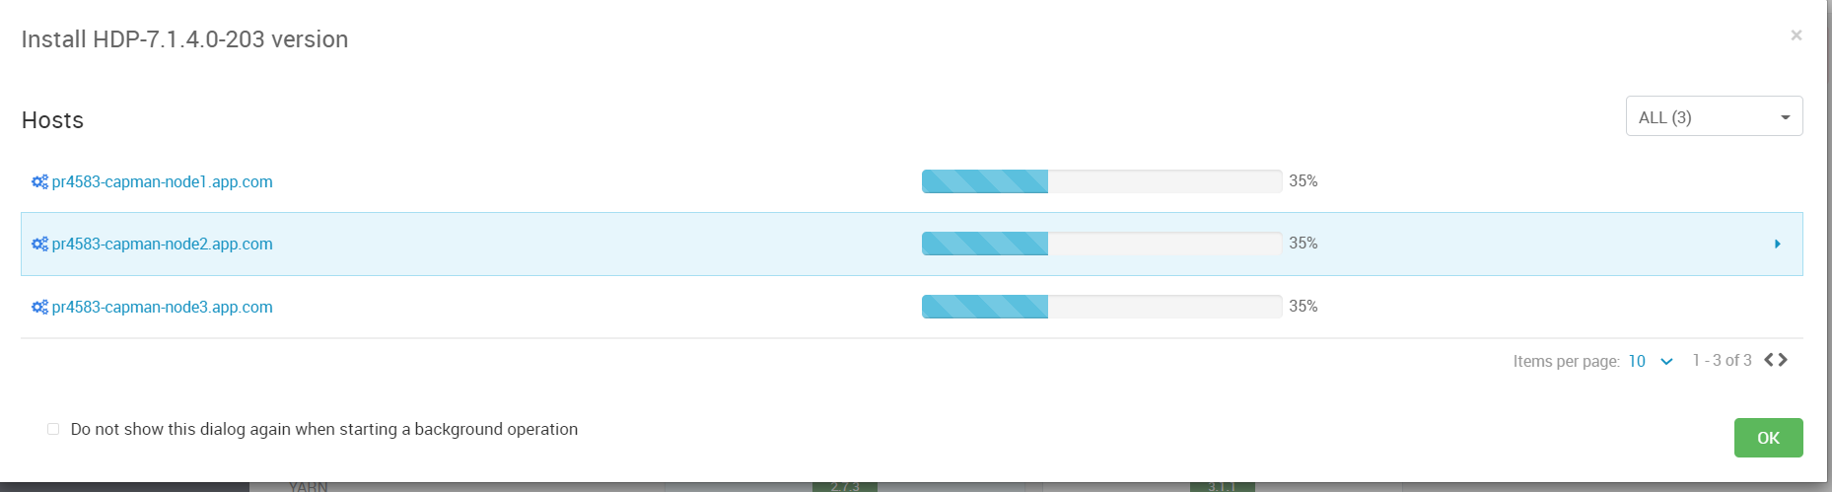
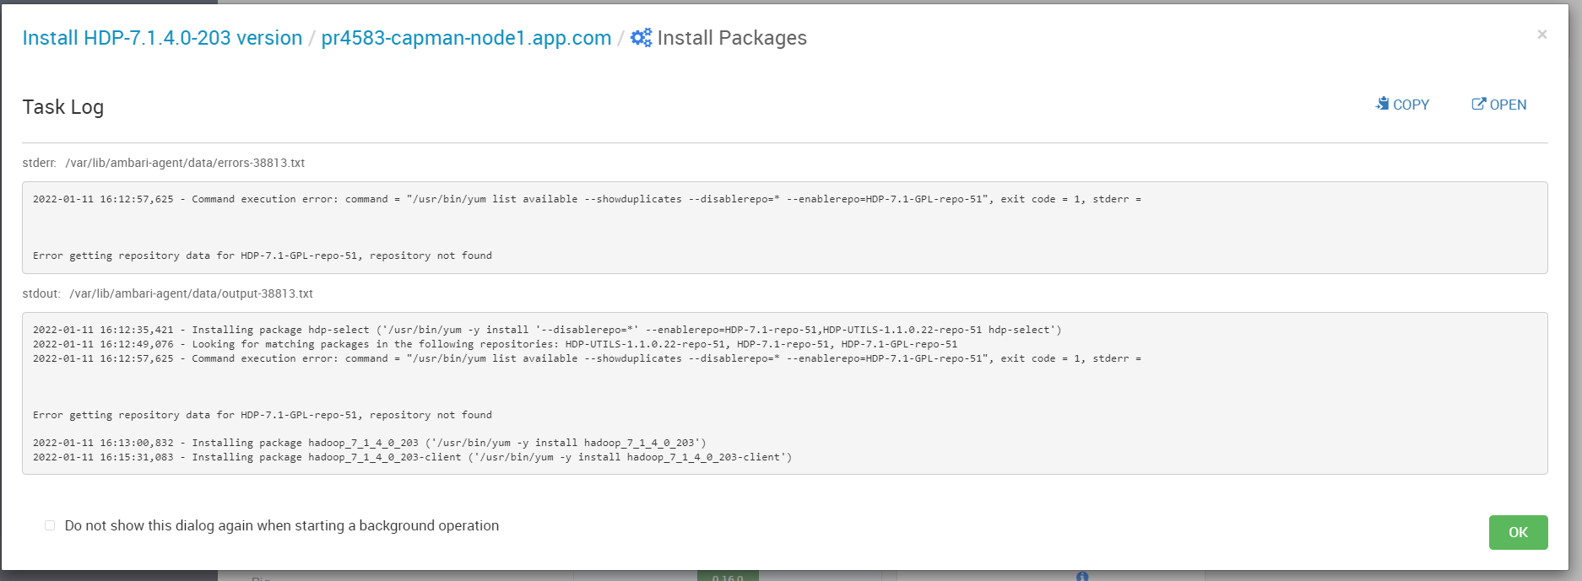
HDP Stack Upgrade to 7.1.4
Post Update of Version File:
Install the new stack:

Slide 17
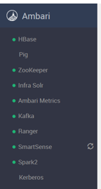
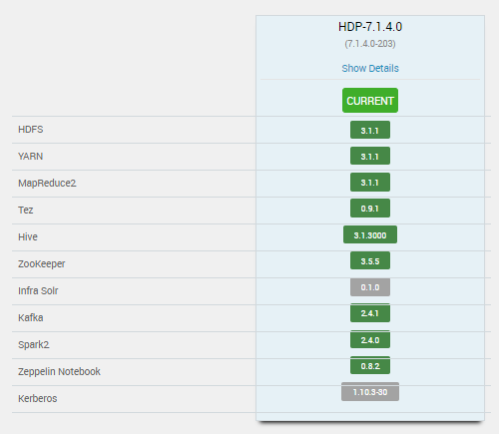
HDP Stack Upgrade to 7.1.4
Upgrade the cluster Stack:
Start all the services and Validate them.

Slide 18
Transition Into Cloudera Manager
Step 1: Cloudera manager installation.
Step 2: Start CM server and agent.
Step 3: Download and configure AM2CM tool.
Step 4: Transition into CM using AM2CM tool.

Slide 19
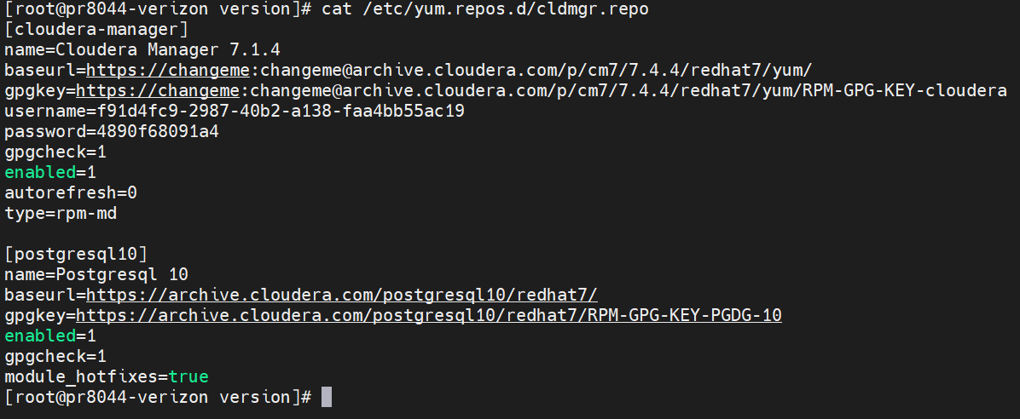
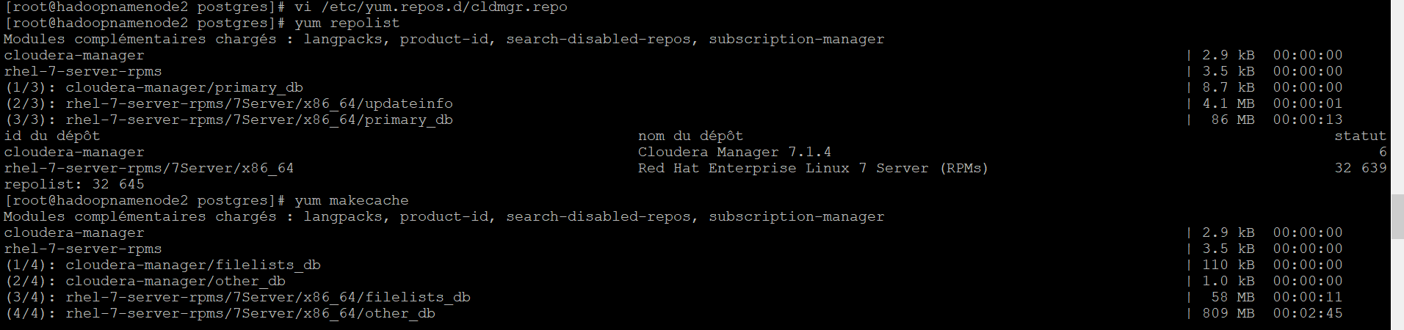
Cloudera Manager Installation
Step 1: Repo Configuration.

Slide 20
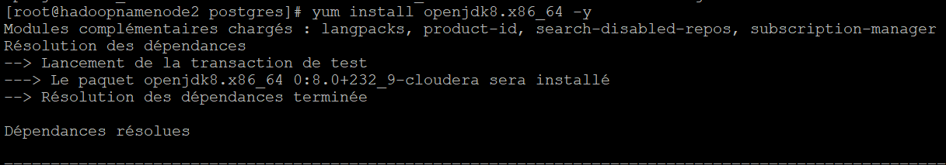
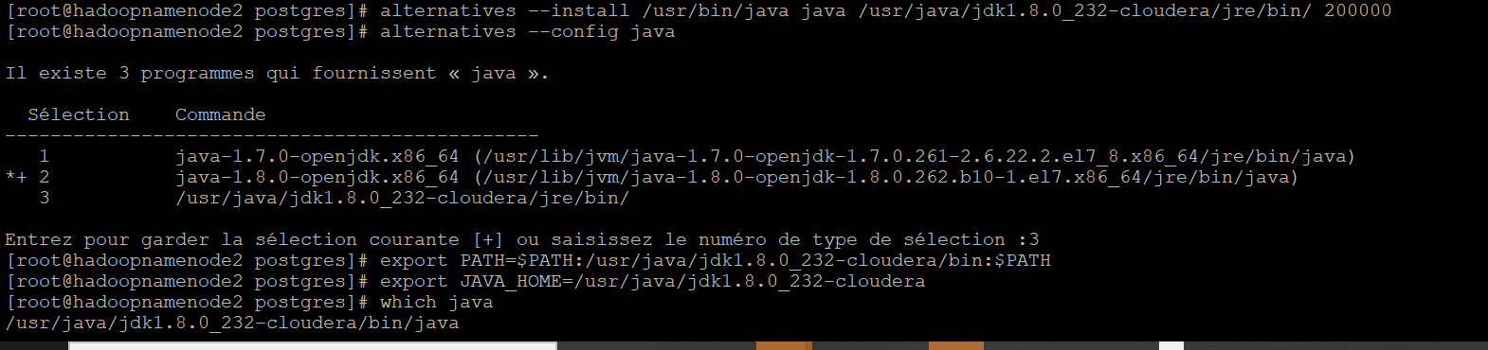
Cloudera Manager Installation
Step 2: Configure JDK.

Slide 21
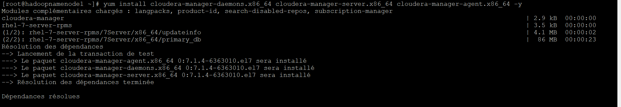
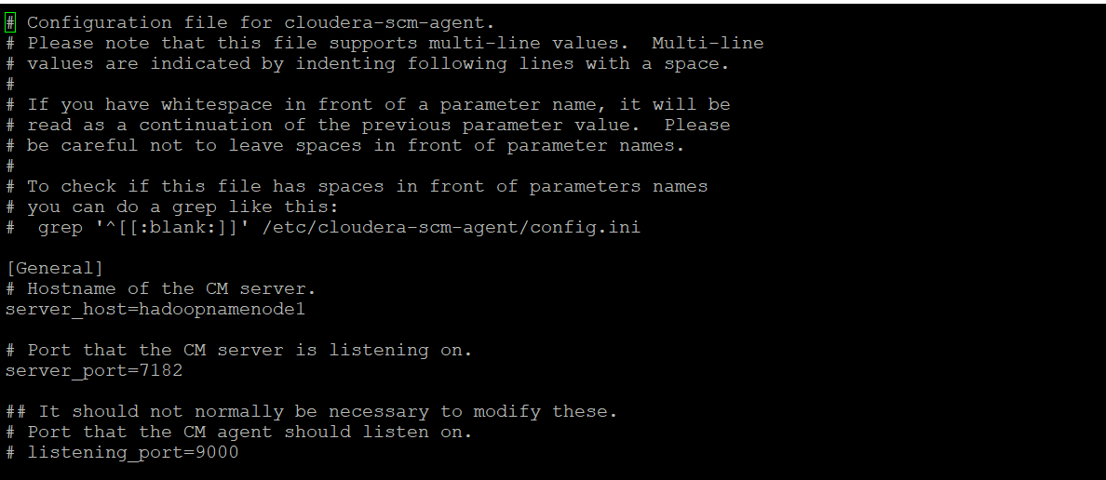
Cloudera Manager Installation
Step 3: Install Cloudera manager packages. (server, Agent and Daemons
Step 4: Point Cloudera manager agent to cloudera manager server.

Slide 22
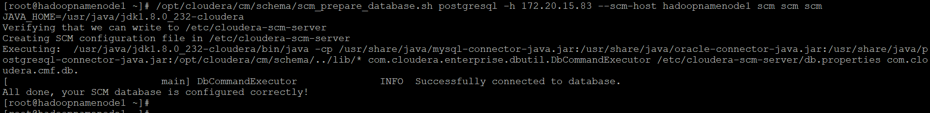
Cloudera Manager Installation
Step 5: Place jdbc connector file.
Step 6: Connect SCM service to the database

Slide 23
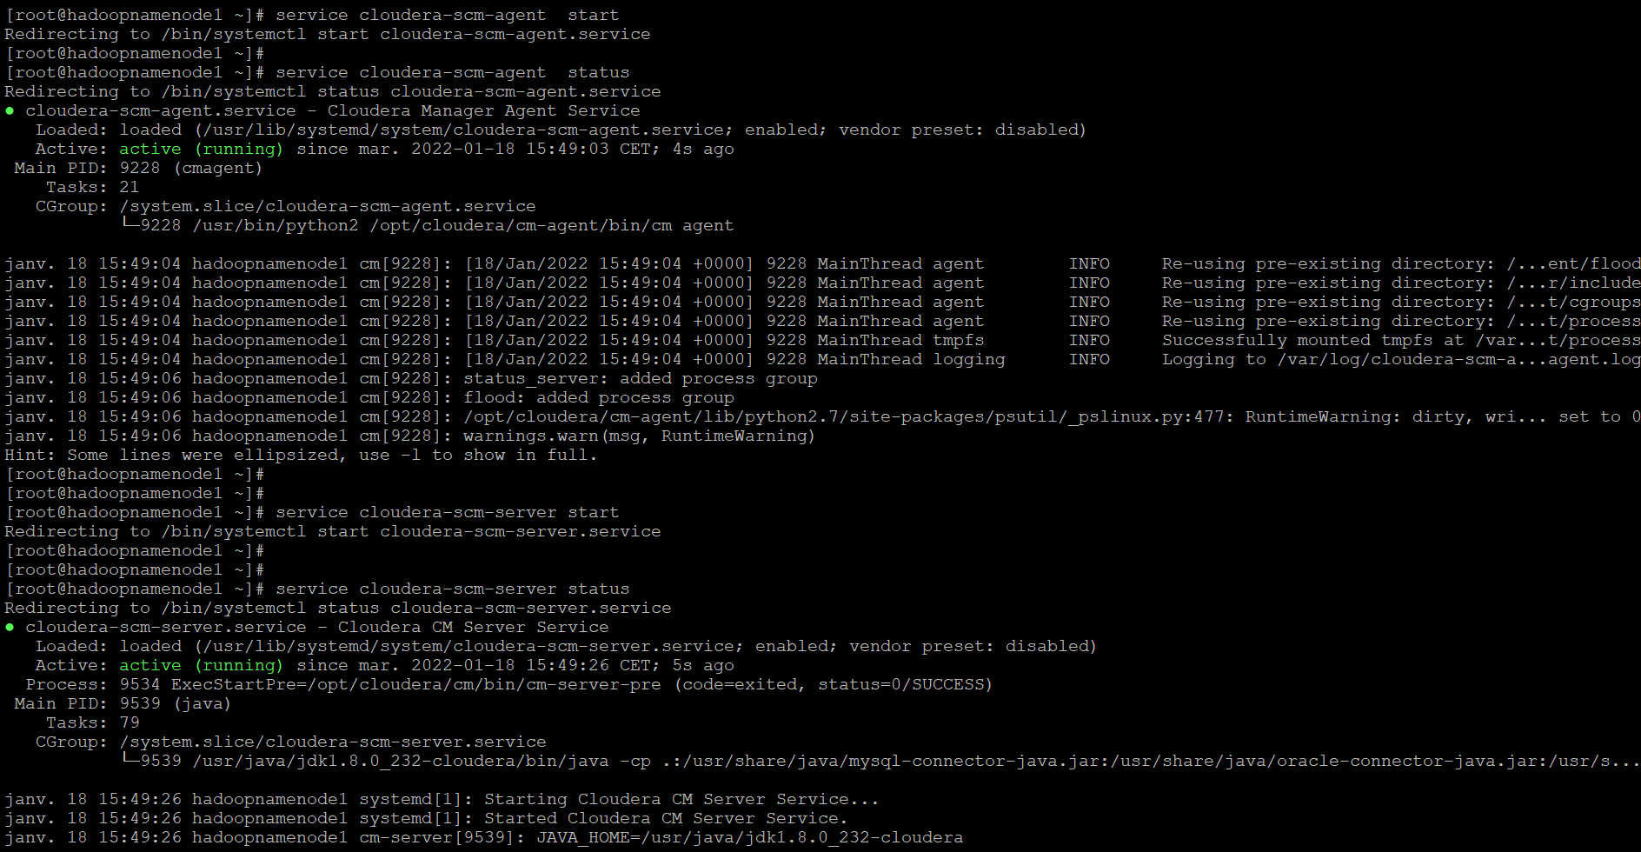
Cloudera Manager Installation
Step 7: Start Cloudera manager servers /agent.

Slide 24
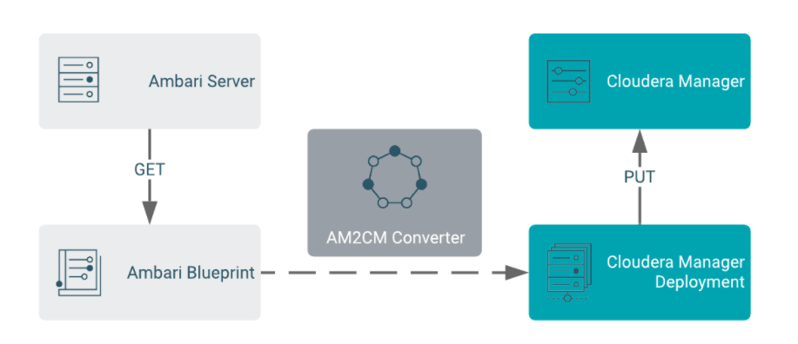
AM2CM Tool

Slide 25
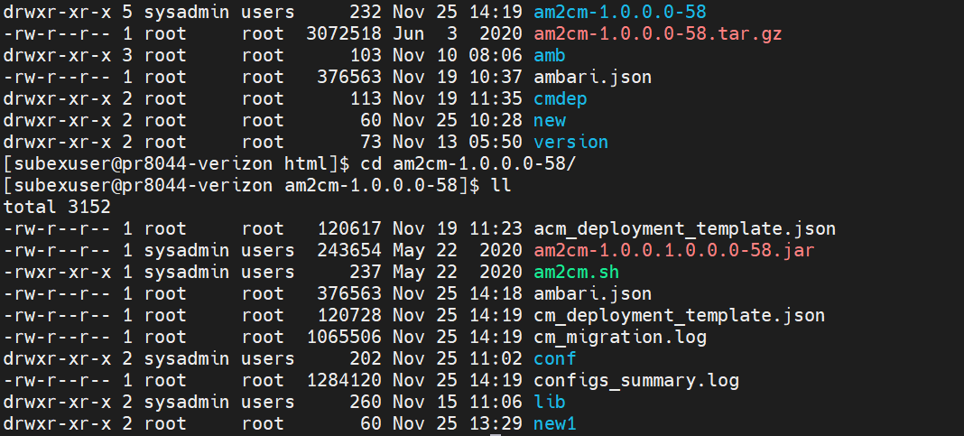
AM2CM
Download the AM2CM tool on your device and upload it on the server.

Slide 26
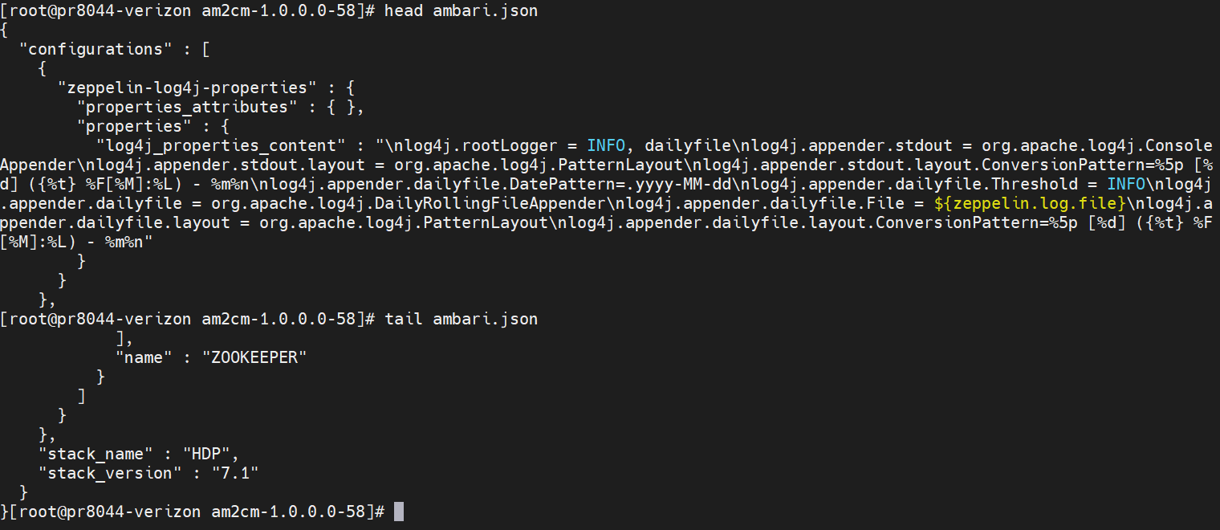
AM2CM
Take Ambari Blueprints in json file format.

Slide 27
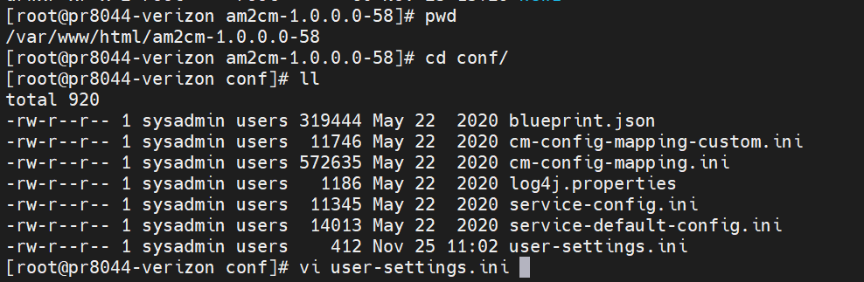
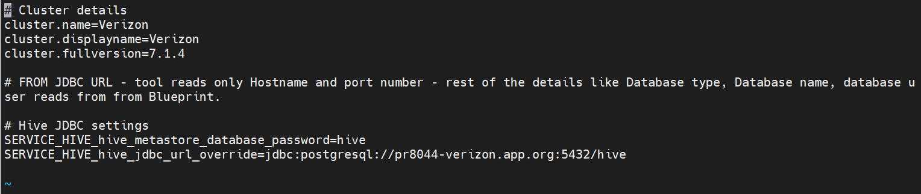
AM2CM
Navigate to the am2cm-2.0.4.0-4/conf/user-settings.ini file and update Parcels, Cluster name, passwords, and JDBC URL information

Slide 28
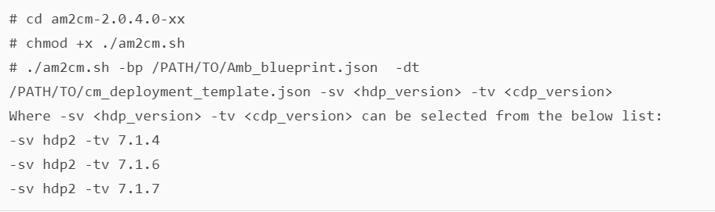
AM2CM
Generate the Cloudera Manager Deployment template

Slide 29

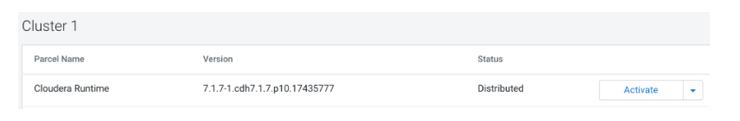
AM2CM
Generate the Cloudera Manager Deployment template USING CLI to transition into cloudera manager for Activation of CDH 7.1.4 parcels
In Cloudera Manager Parcel screen, download Cloudera Runtime and distribute the parcel. Cloudera Manager deploys the parcel to the cluster hosts. The default is 10 concurrent hosts. You can adjust this to a maximum of 50 by increasing the setting in the Other Parcel Configurations screen, but must be configured before the template is applied.

Slide 30
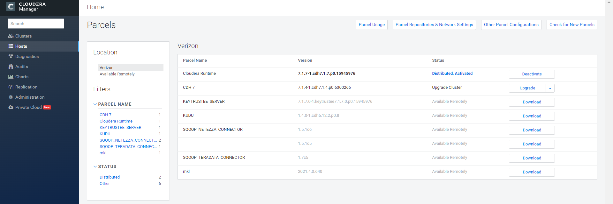
AM2CM
Parcel Configuration on the Cluster

Slide 31
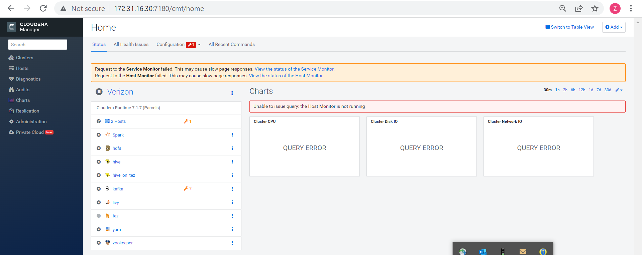
Cloudera Manager
Post Transition Steps :: Cluster Status

Slide 32
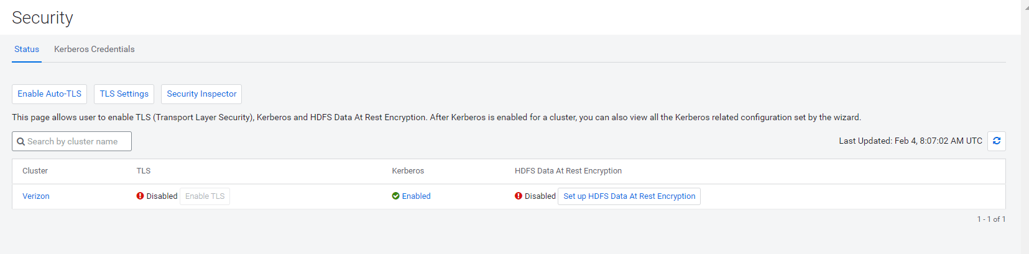
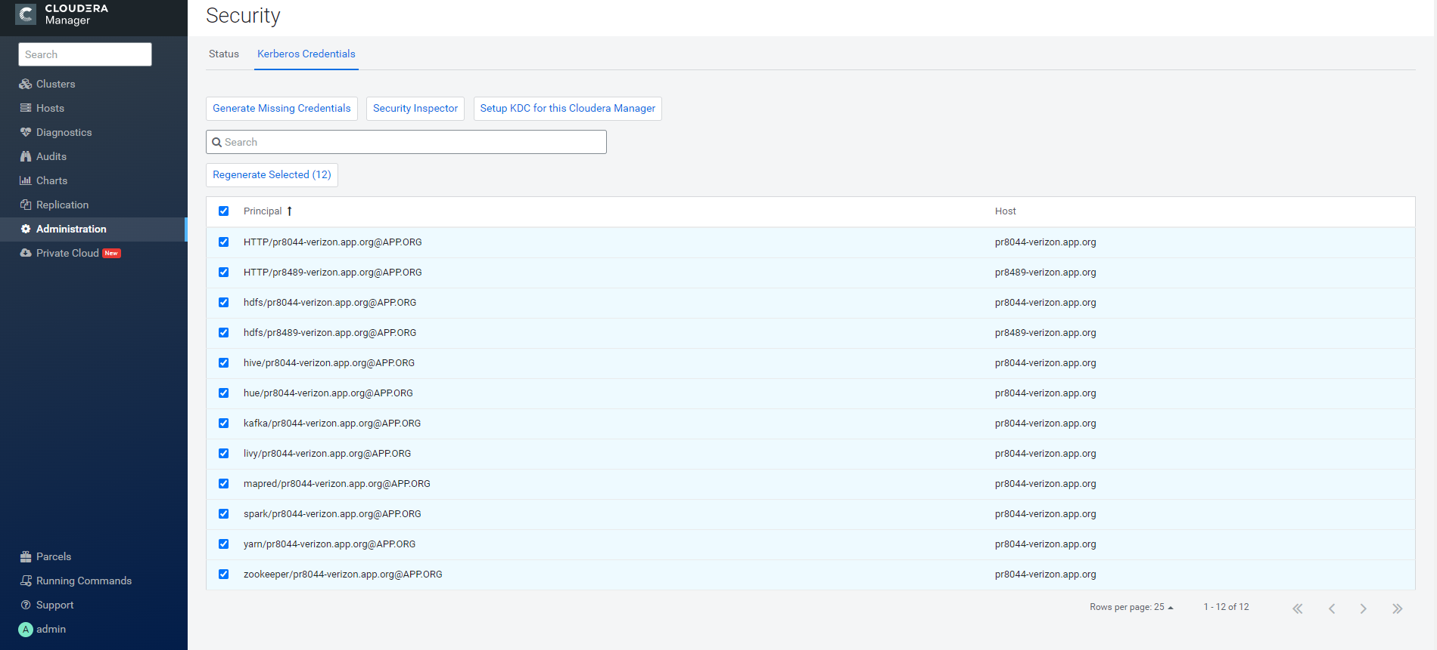
Cloudera Manager
Post Transition Steps :: Regenerate Missing Kerberos Credentials

Slide 33
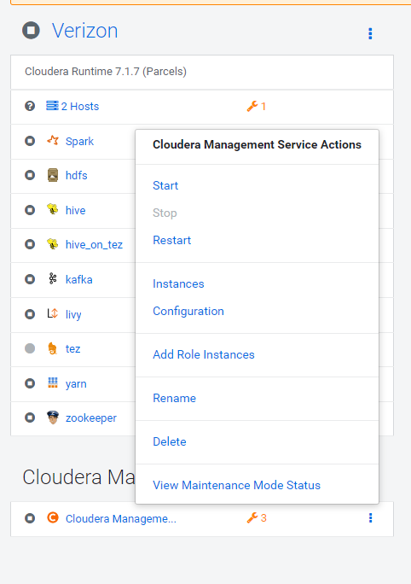
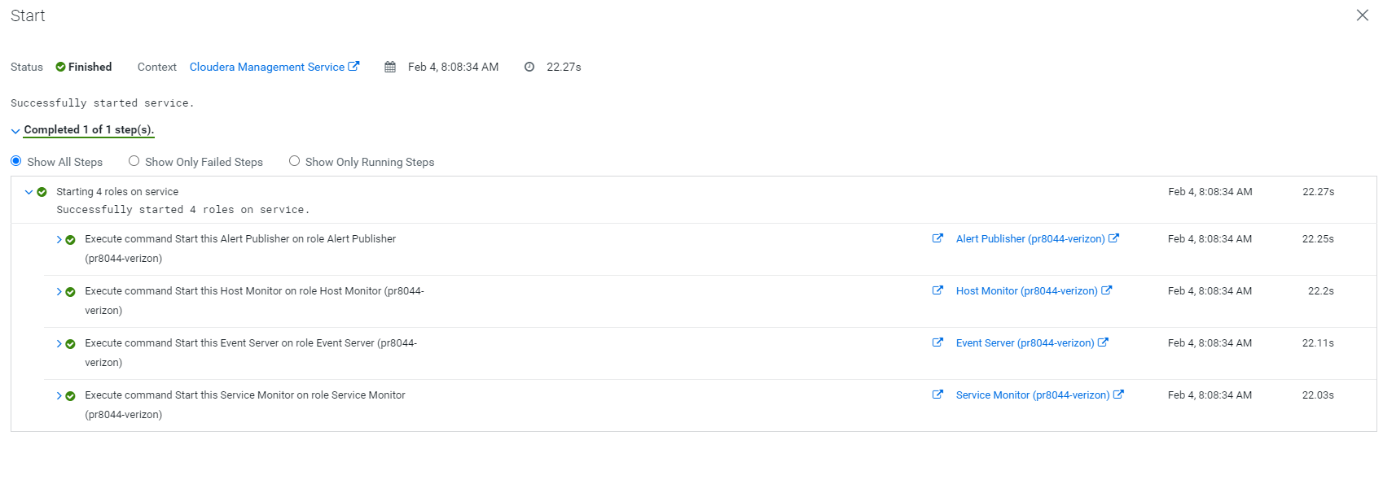
Cloudera Manager
Post Transition Steps :: Start Cloudera Management Services

Slide 34
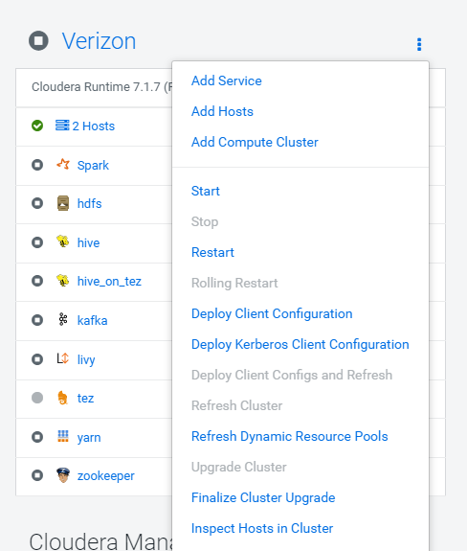
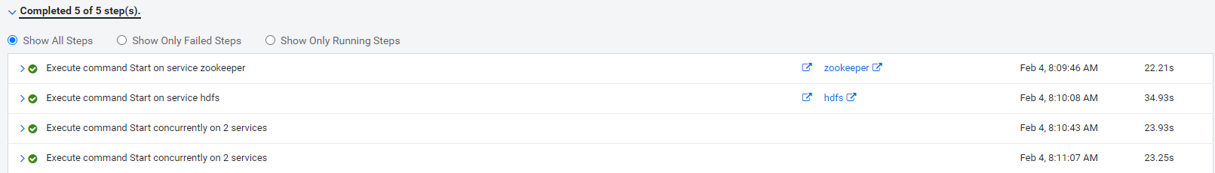
Cloudera Manager
Post Transition Steps :: Start CDP services

Slide 35
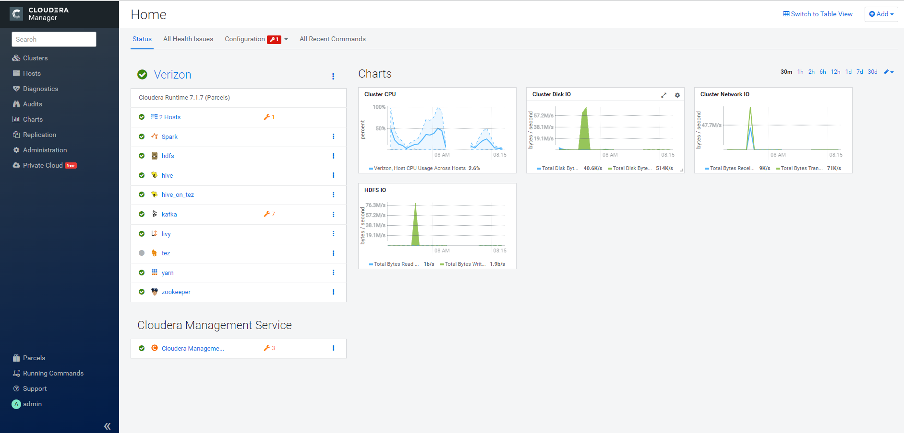
Cloudera Manager
Post Transition Steps :: Cluster Status Health Check

Slide 36
Thank you

